Slide 1

ACCRA TECHNICAL UNIVERSITY Bachelor Of Technology in Electrical and Electronic Engineering
HOSPITAL PATIENT QUEUE MANAGEMENT SYSTEM
Introduction To Computer Programming(c++)I
FINAL PROJECT
LEVEL 200
(BEE 208)
2025/2026 ACADEMIC YEAR

Slide 2
Introduction
The Hospital Patient Queue Management System is a software application developed using C++.
The system is designed to assist hospitals in managing patient queues efficiently.
It registers patients and assigns queue numbers automatically.
Patients are categorized as Emergency, Priority, or Regular.
The system stores patient information and generates reports.

Slide 3
Problem Statement
Many hospitals experience challenges in managing patient queues manually. These challenges include:
Longe waiting for patients.
Difficult prioritizing emergency cases.
Poor record keeping and queue management.
This project provides a computerized solution to improve patient queue management and service delivery.

Slide 4
Objective
General Objectives
To develop a Hospital Patient Queue Management system using C++.
Specific Objectives
Register patient into the system.
Assign queue numbers automatically.
Classify patients as Emergency, Priority, or Regular.
Manage patient records efficiently.
Generate reports and save them to a text file.

Slide 5
Scope Of The Project
Patient registration.
Queue number assignment.
Priority classification ( Emergency, Priority and Regular ).
Patient record management.
Report generation and storage using text file.
The system does not include billing, appointment scheduling, or pharmacy management.

Slide 6
System Requirements
Hardware Requirements
Computer or laptop
Keyboard
Monitor
Software Requirements
Code::Blocks IDE
C++ Compiler
Windows Operating System

Slide 7
Methodology
Gather patient information.
Assign queue numbers.
Determine patient priority.
Store records.
Generate reports.

Slide 8
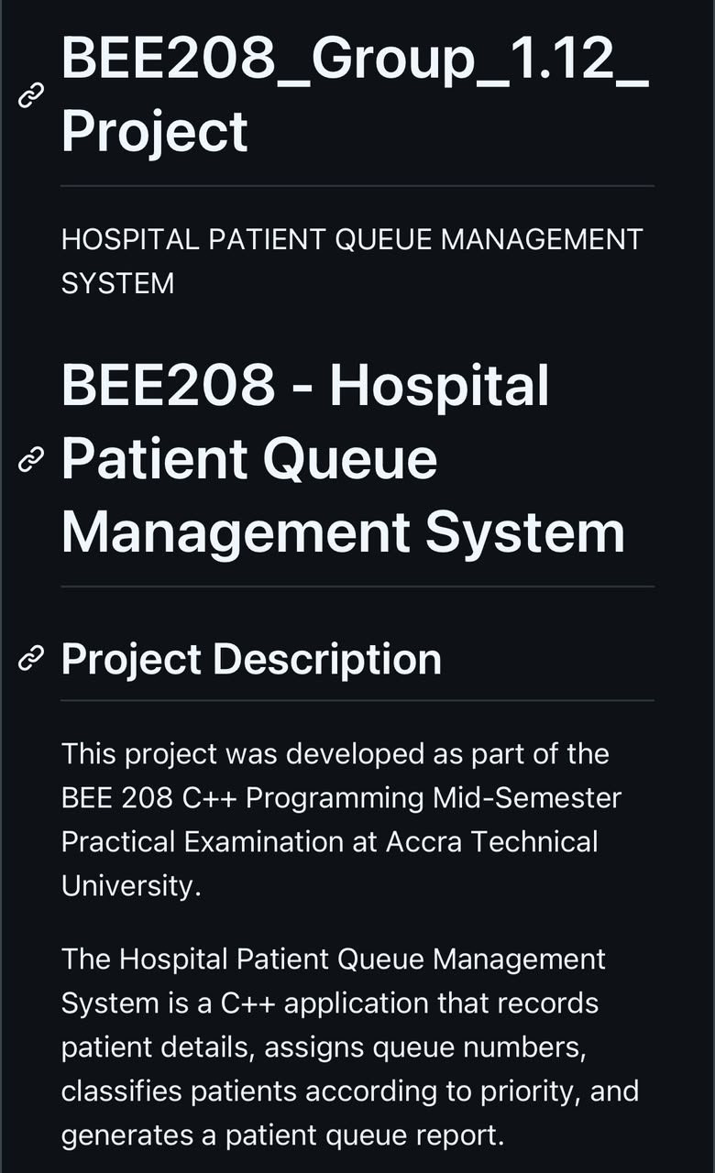
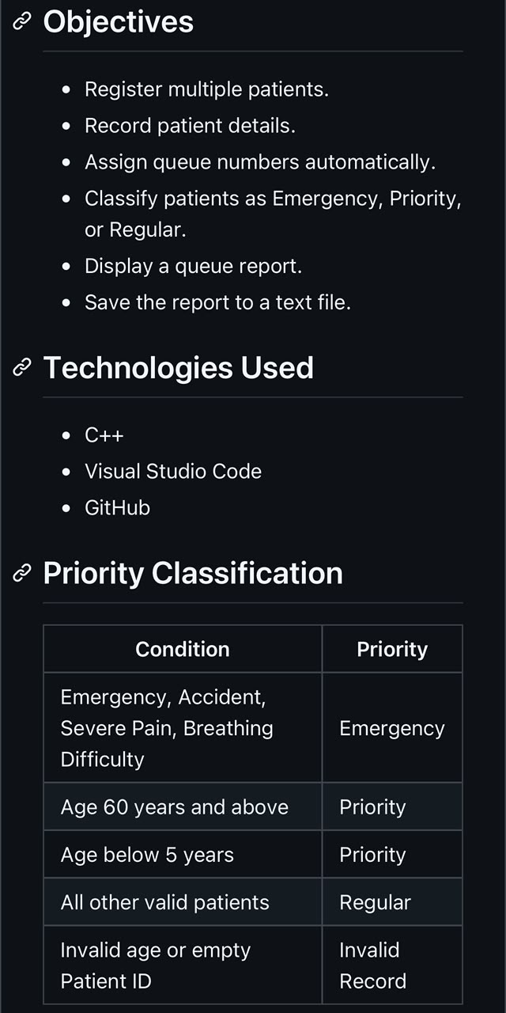
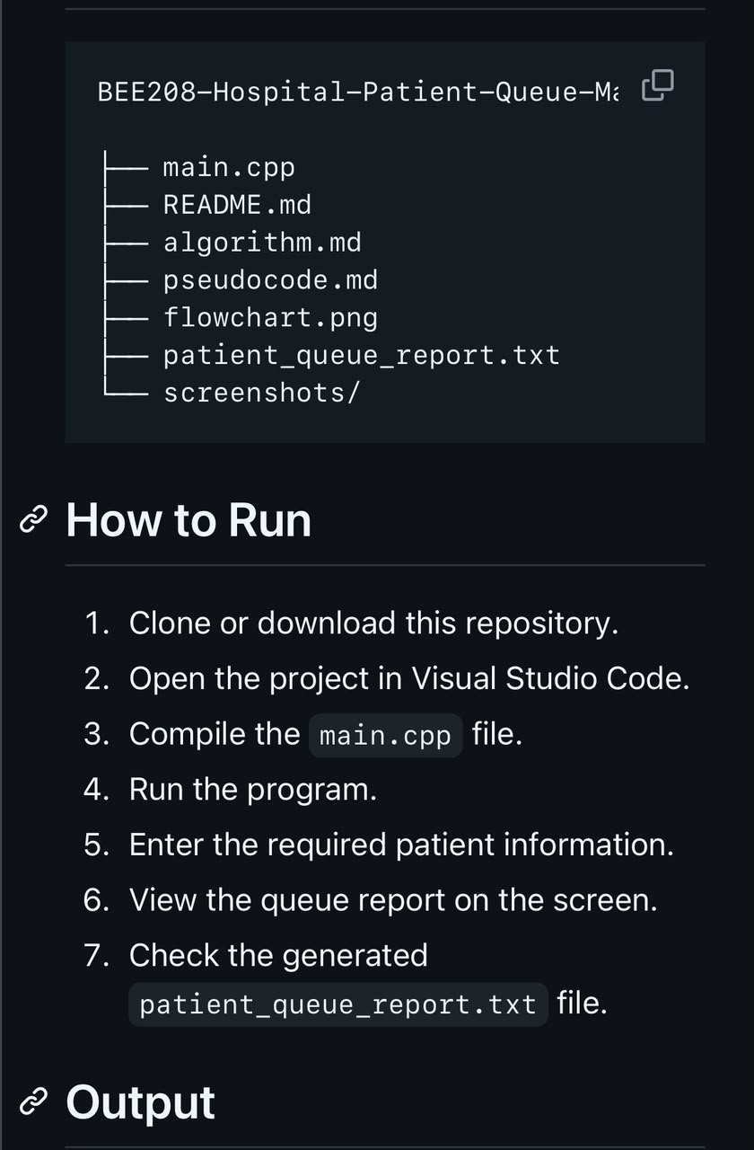
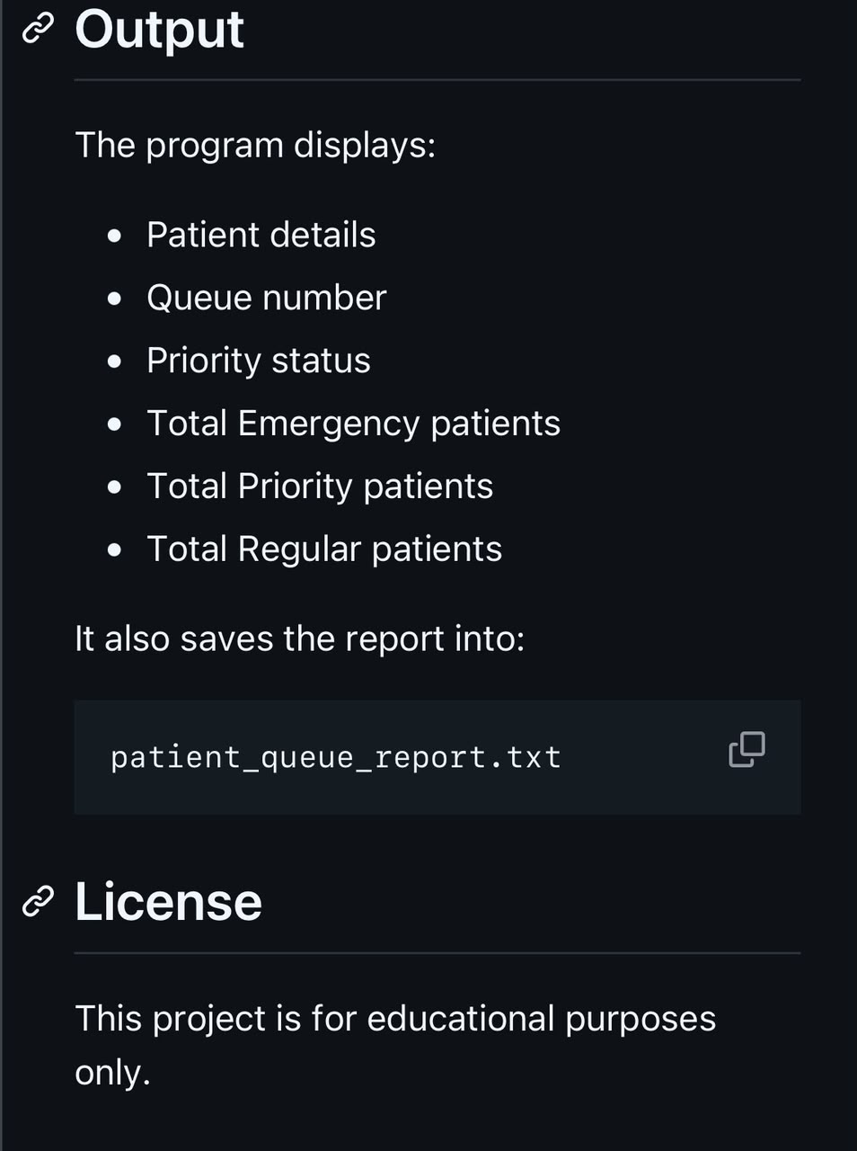
README.md

Slide 9
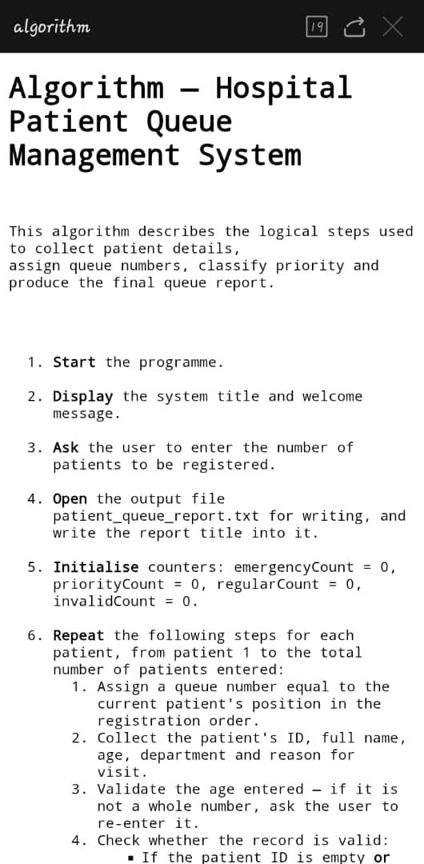
Algorithm

Slide 10
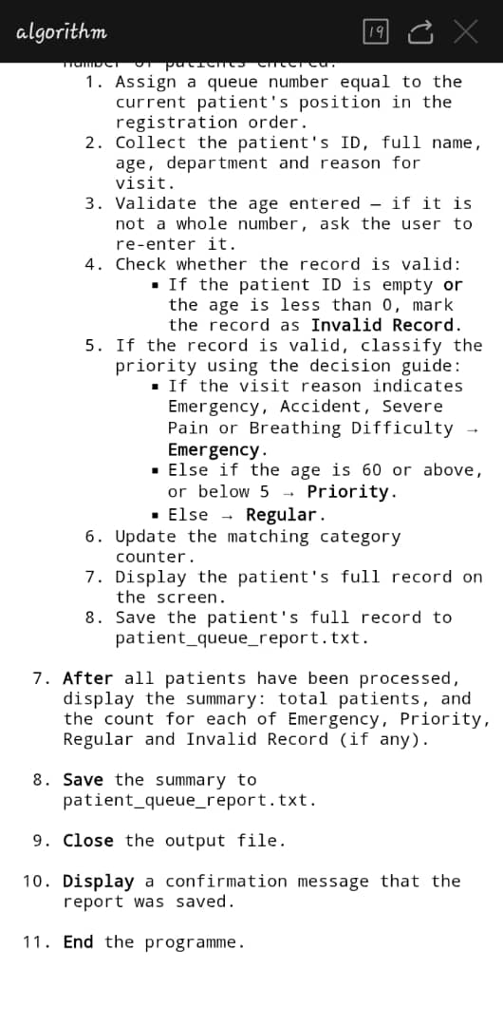

Slide 11
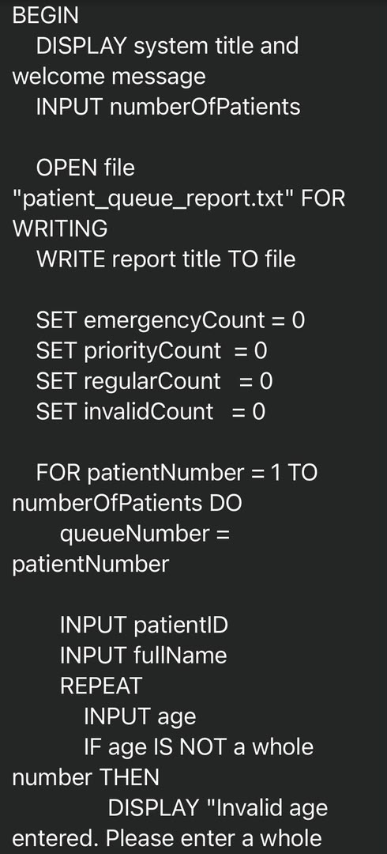
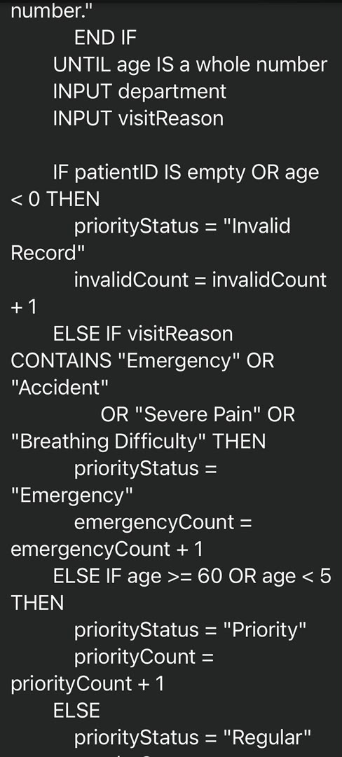
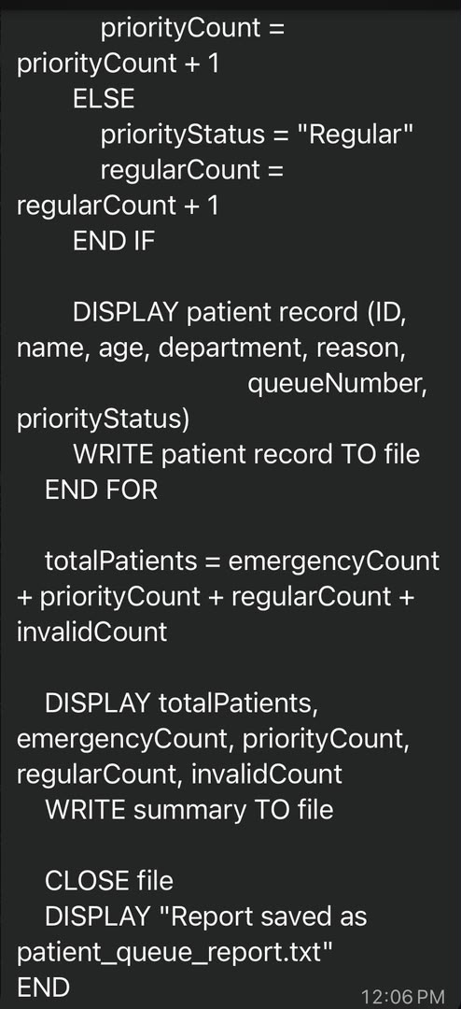
Pseudocode

Slide 12
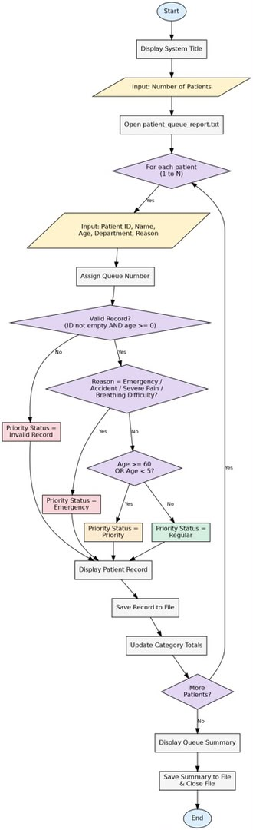

Slide 13
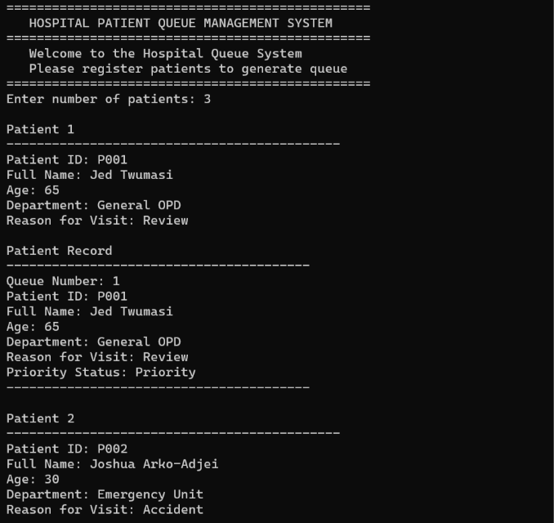
Test and validation

Slide 14
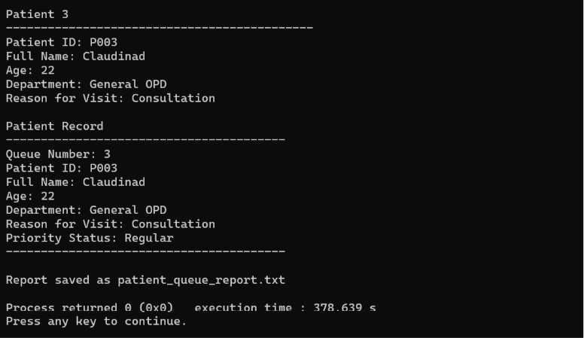

Slide 15
Program Implementation
Programming Language: C++
Use file handling.
Use queue management logic.
Generate patient reports.

Slide 16
Conclusion
The system helps manage patient queue efficiently
Emergency patients receive higher priority.
Patient records can be stored and retrieved easily.
The system improves hospital service delivery.

Slide 17
Group 1.12 Members
Apuko Gifty (01242246B) – Documentation lead
Komlakumah Wisdom (01246286B) – Presentation lead
Abaahom Sethyna Sey (01245742B) – Project lead and final coordination
Joel Luke Kwadwo Agyei Henaku (01244782B) – Algorithm writer
Sulemana Raihan Tunteya (01243253B) – Pseudocode writer
Odia Claudinad Afotey (01246485B) – Github repository manager
Lamptey Nicholas (01245079B) – Testing and validation lead
Ankomah Richard Bamfo (01242255B) – Flowchart designer
Twumasi Jedrek Ankrah(01243971B) – C++ programmer
Arko-Adjei Joshua Budu (01243985B) – C++ Programmer

